Slide 1
Graphs
EECS 233

Slide 2
Many Data Structures Learned
Lists (arrays, linked lists)
Stacks and queues
Trees
  With various structural and key ordering constraints
  In-memory and external
Hash tables
  In-memory and external (extendible)
Next up: graphs

Slide 3
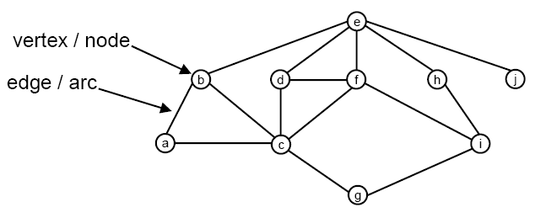
What Is A Graph?
A graph consists of:
  a set of vertices (also known as nodes)
  a set of edges (also known as arcs), each of which connects a pair of vertices
Q: Can any two vertices reach each other?

Slide 4
Example: A Highway Map
Detroit
Buffalo
191
281
60
Chicago
244
117
Cleveland
216
Toledo
135
181
143
198
Pittsburgh
185
Indianapolis
110
101
Columbus
Cincinnati
Vertices represent cities, and edges represent highways.
This is a weighted graph: it associates a cost with each edge (in this example, the cost represents mileage)

Slide 5
Why Graphs
Many applications of graphs (and hence graph data structures and algorithms)
Example 1: What is the shortest path between Pittsburgh and Chicago in the example graph?
Detroit
Buffalo
191
281
60
Chicago
244
117
Cleveland
216
Toledo
135
181
143
198
Pittsburgh
185
Indianapolis
110
101
Columbus
Cincinnati

Slide 6
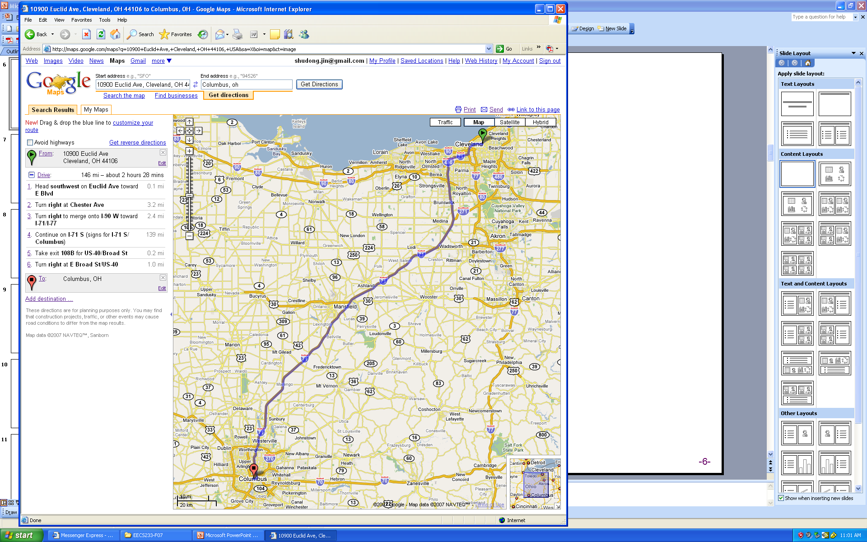
Google Maps uses graph(s)

Slide 7
Social network is a graph
People = nodes
Friend relationships = undirected edges
“Following” relationship = directed edges
Degree of separation = shortest paths

Slide 8
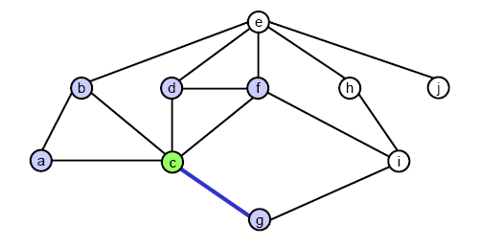
Terminology
Two vertices are adjacent if they are connected by a single edge.
  example: c and g are adjacent, but c and i are not
The collection of vertices that are adjacent to a vertex v are referred to as v’s neighbors.
  example: c’s neighbors are a, b, d, f, and g

Slide 9
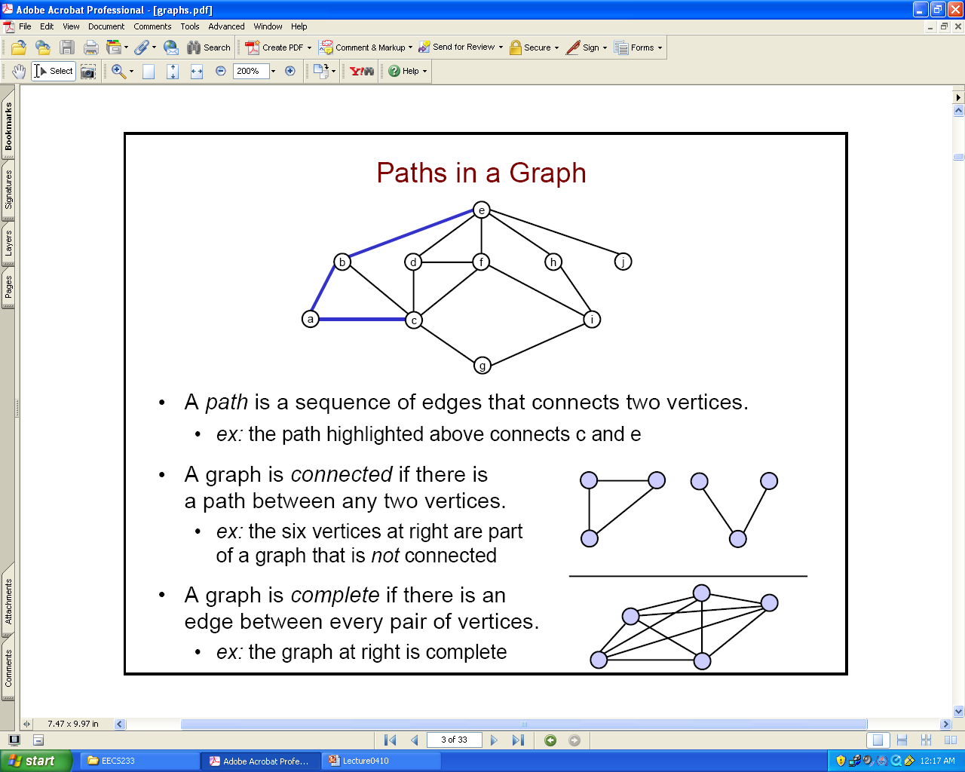
Terminology
A path is a sequence of edges that connects two vertices.
  example: the path connects c and e
A graph is connected if there is a path between any two vertices.
  example: the graph at right is not connected
A graph is complete if there is an edge between every pair of vertices.
  example: the graph at right is complete

Slide 10
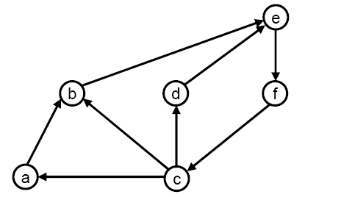
Directed versus Undirected Graphs
A directed graph has a direction associated with each edge, which is depicted using an arrow:
Edges in a directed graph are often represented as ordered pairs of the form (start vertex, end vertex).
  example: (a, b) is an edge in the graph above, but (b, a) is not.
A path in a directed graph is a sequence of edges in which the end vertex of edge i must be the same as the start vertex of edge i + 1.
  ex: { (a, b), (b, e), (e, f) } is a valid path.
  { (a, b), (c, b), (c, a) } is not.

Slide 11
More Terminology
Degree
  In-degree and out-degree
Distance, hop-distance or path length
DAG – directed acyclic graph

Slide 12
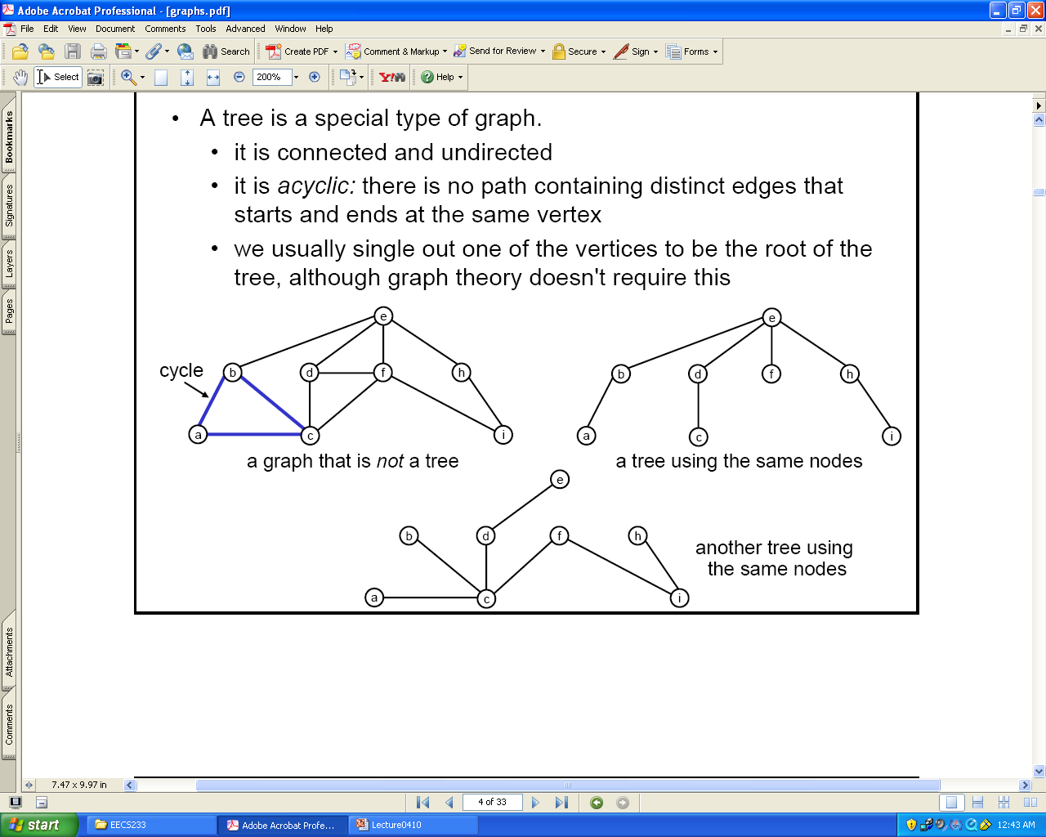
Trees versus Graphs
A tree is a special type of graph.
  it is connected and undirected
  it is acyclic: there is no path containing distinct edges that starts and ends at the same vertex
  we usually single out one of the vertices to be the root of the tree, although graph theory doesn't require this
A graph that is not a tree

Slide 13
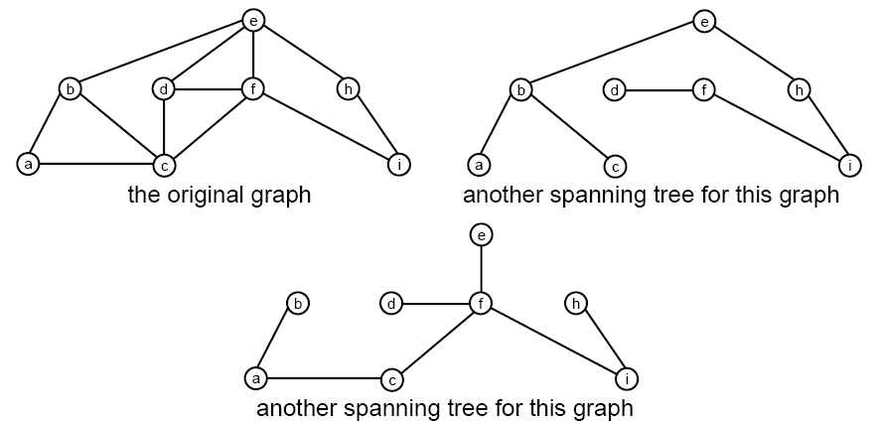
Spanning Trees
A spanning tree is a subset of a connected graph that contains:
  all of the N vertices
  a subset of the edges that form a tree (the subset contains N-1 edges)
Examples:
  the two trees on the previous slide, and

Slide 14
Graph Representation - Matrix
Adjacency matrix = a two-dimensional array that is used to represent the edges and any associated costs
  edge[r][c] = the cost of the link from vertex r to vertex c
  Use a special value to there is no direct link from r to c.
This representation is good if the graph is dense – if most nodes are connected – but wastes memory if the graph is sparse – if it has few edges per vertex.
Buffalo
Buf
Cle
Pitt
Col
191
Buffalo
X | 191 | 216 | ?
191 | X | 135 | 143
216 | 135 | X | 185
? | 143 | 185 | X
Cleveland
216
Cleveland
135
Pittsburgh
143
Pittsburgh
185
Columbus
Columbus

Slide 15
Graph Representation - Lists
Adjacency lists = a set (either an array or linked list) of linked lists that is used to represent the edges and any associated costs
This representation is good if a graph is sparse, but inefficient if the graph is dense.
  no memory is allocated for non-existent edges
  the references in the linked lists use extra memory
  List traversal to find a link
1
191
2
216
Buf
Cle
Pitt
Col
0
Buffalo
null
Buffalo
X | 191 | 216 | ?
191 | X | 135 | 143
216 | 135 | X | 185
? | 143 | 185 | X
1
0
191
2
135
3
185
Cleveland
Cleveland
null
2
Pittsburgh
?
Pittsburgh
Columbus
3
Columbus
?

Slide 16
An Alternative Representation
Use references/pointers instead of index.
vertices
Buf
Cle
Pitt
Col
191
216
null
Buffalo
X | 191 | 216 | ?
191 | X | 135 | 143
216 | 135 | X | 185
? | 143 | 185 | X
Buffalo
Cleveland
191
135
185
Pittsburgh
Cleveland
null
Columbus
?
Pittsburgh
?
Columbus
null

Slide 17
Graph Representation with Lists
public class Graph {
  class Vertex {
    private String id;
    private Edge edgeHead; // adjacency list
    private boolean encountered;
    private boolean done;
    private Vertex parent;
    private double cost;
    …
  }
  class Edge {
    private int endNode;
    private double cost;
    private Edge next;
    …
  }
  private Vertex[] vertices;
  private int numVertices;
  private int maxNum;
  …
}
public class Graph {
class Vertex {
private String id;
private LinkedList <Edge> edges; // adjacency list
private boolean encountered;
private boolean done;
private Vertex parent;
private double cost;
…
}
class Edge {
private int endNode;
private double cost;
…
}
private Vertex[] vertices;
private int numVertices;
private int maxNum;
  …
}
1
191
2
216
0
Buffalo
null
1
0
191
2
135
3
185
Cleveland
null
2
Pittsburgh
?
3
Columbus
?

Slide 18
Adding Nodes
public class Graph {
  class Vertex {
    private String id;
    private LinkedList <Edge> edges; // adjacency list
    private boolean encountered;
    private boolean done;
    private Vertex parent;
    private double cost;
    …
  }
  class Edge {
    private int endNode;
    private double cost;
    …
  }
  private Vertex[] vertices;
  private int numVertices;
  private int maxNum;
  …
}
public Graph(int maximum) {
  vertices = new Vertex[maximum];
  numVertices = 0;
  maxNum = maximum;
}
public int addNode(String id)
{
  // code to grow vertices if array “vertices”
  // is too small to have another node
  …
  vertices[numVertices] = new Vertex(id);
  // any further initialization
  …
  numVertices++;
  return numVertices-1; // return the index
}

Slide 19
Adding Edges
public class Graph {
  class Vertex {
    private String id;
    private LinkedList <Edge> edges; // adjacency list
    private boolean encountered;
    private boolean done;
    private Vertex parent;
    private double cost;
    …
  }
  class Edge {
    private int endNode;
    private double cost;
    …
  }
  private Vertex[] vertices;
  private int numVertices;
  private int maxNum;
  …
}
public void addEdge(int i, int j, double cost)
{
  // add an edge from i to j
  Edge newEdge = new Edge();
  newEdge.endNode = j;
  …
  vertices[i].edges.add(newEdge);
  // add an edge to j for node i
  newEdge = new Edge();
  newEdge.endNode = i;
  …
  vertices[j].edges.add(newEdge);
}

Slide 20
1
191
2
216
0
Buffalo
null
1
0
191
2
135
3
143
5
117
Cleveland
null
0
191
1
135
3
185
2
Pittsburgh
null
3
Columbus
1
143
2
135
4
101
null
4
Cincinnati
3
101
5
198
8
110
null
5
Toledo
1
117
4
198
6
60
7
244
null
6
Detroit
5
60
7
281
null
7
Chicago
5
244
6
281
8
181
null
8
Indianapolis
4
110
7
181
null

